Slide 1
MNIST Digit Classification
Machine Learning
Presented By: Muhammad Salman Akhtar 398895
Muhammad Qaisar 360662
Aizaz Omer 398895

Slide 2
Content
Introduction
Background
MNIST Dataset
Model Architecture
Methodology
Evaluation
Results & Discussion
Experimental results analysis
Conclusion

Slide 3
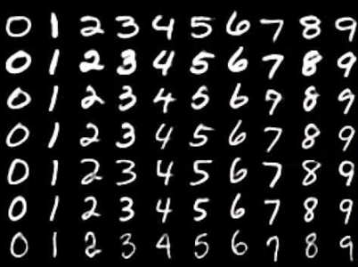
Introduction
Image Classification Task
Computer Vision Domain
Applications of Handwritten Digits Classifier
Postal address identification
Automated bank checks processing
Breaking of image captchas (malicious use)

Slide 4
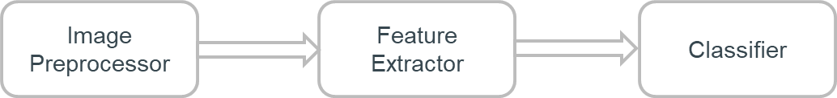
Traditional Computer Vision Classifiers
Rely on Separate Task Specific Modules
Image pre-processor
Feature extractor (SIFT, SURF, HOG etc)
Classifier

Slide 5
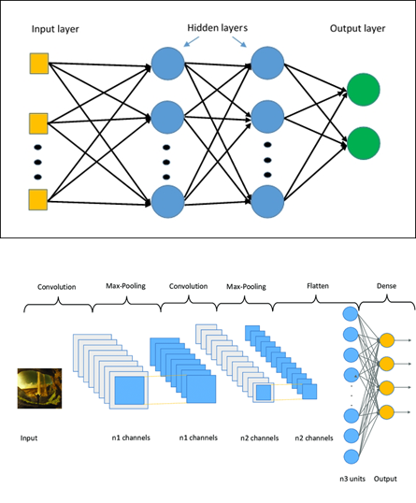
Computer Vision with Deep Learning
Introduction of End-to-End Learning
Multi Layer Perceptron
Densely connected
Not suitable for images
Convolutional Neural Networks
LeNet

Slide 6
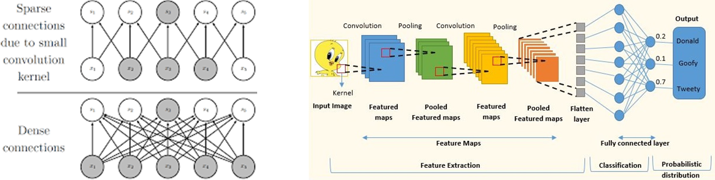
Convolutional Neural Network
Sparsely Connected
Shared Weights
Suitable for Structured Data (Images, Voice)

Slide 7
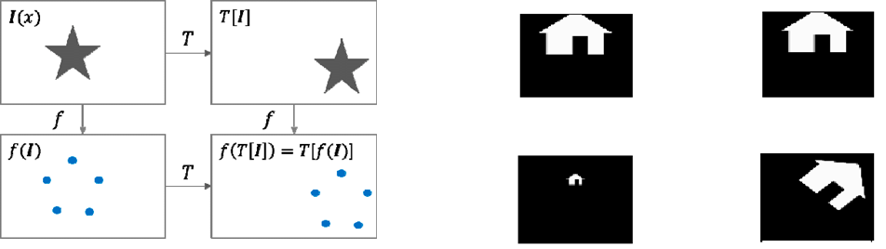
Robust Feature Extractors
Robust Feature Extractor
Translational Equivariance
Geometric Invariance
Scale, Rotation, Affine transformations
Photometric Invariance
Brightness, Contrast

Slide 8
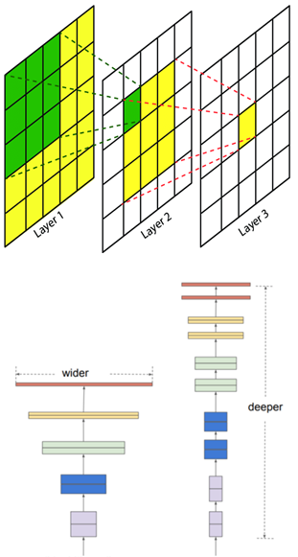
Convolutional Neural Network Hyperparameters
Kernel Size
Varies Receptive Field
Number of Filters
Width of Network
Increases number of feature maps
Increases diversity in the extracted features
Number of Layers
Encodes information
Earlier layers learn simple features
Deeper layers learn more complex shapes

Slide 9
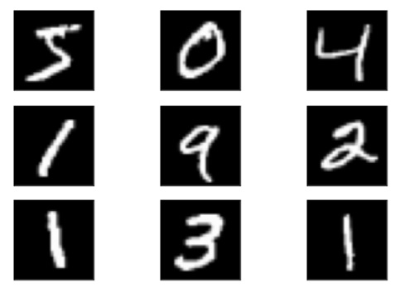
MNIST Dataset
Modified MNIST (National Institute of Standards and Technology)
Massive collection of computer vision datasets
Built by using two NIST datasets
Binary pictures of handwritten numbers
Digits are
Size-normalized and centered
Handwritten digits from 250 persons
Half from Census Bureau employees
Half from high school students
28x28 pixels

Slide 10
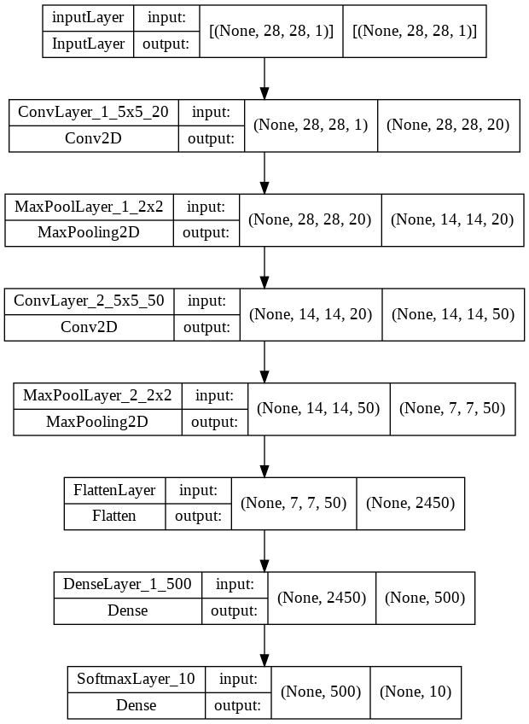
Model Architecture
Two convolution layers
Kernel size 5x5
Followed by a ReLU activation function
Max-pooling layer
Followed by each covnet layer
Kernel size of 2
Stride of 2
Flatten layer leading to a dense layer
ReLU activation and another dense layer
A softmax activation function

Slide 11
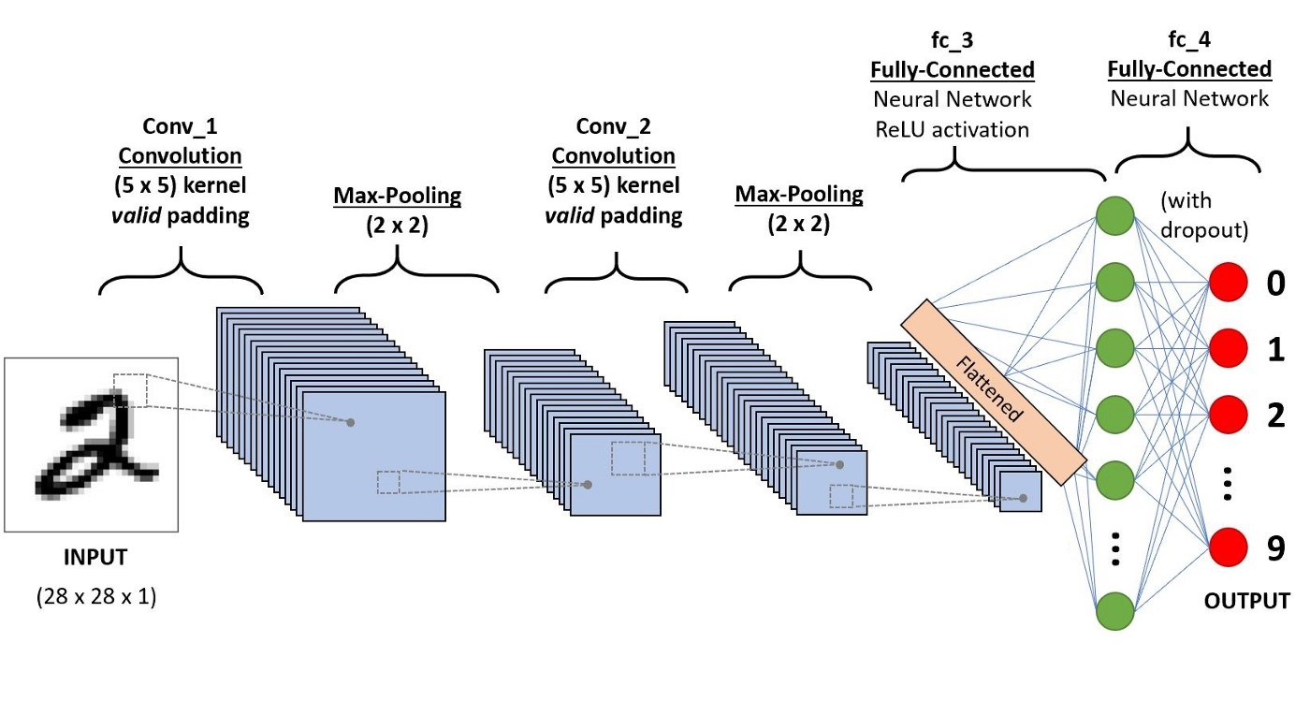
CNN Model

Slide 12
Model Compilation
Due to multi-class classification
Cross-entropy as our loss function
Softmax function
Used RMSprop optimizer
Learning rate of 0.001 to optimize the model parameters
Enumerate function over the data loader to loop through batches
Input the batch of image tensors into the mode
Tensor with predictions for that batch

Slide 13
Validation/Evaluation
Forward propagation steps
Compared the model’s prediction to the actual labels
To estimating the model’s accuracy
Accuracy/loss
Sum of losses for each batch iteration
Lowest training loss of 0.2
Highest training accuracy of 0.945

Slide 14
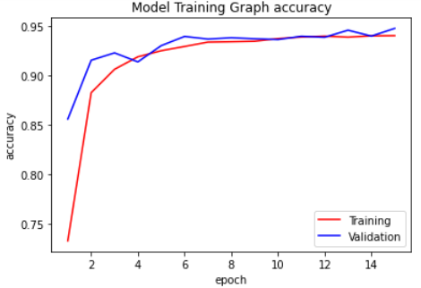
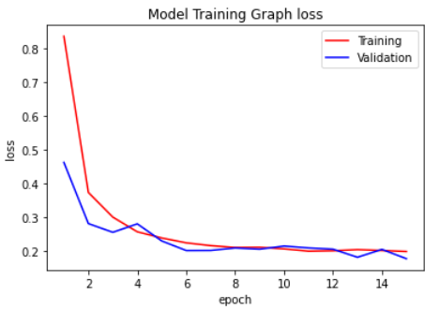
Training Accuracy & Loss

Slide 15
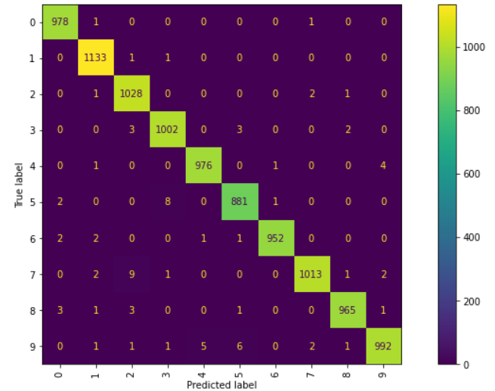
Results
Performance on MNIST Dataset: Accuracy: 99.2% (Confusion Matrix)

Slide 16
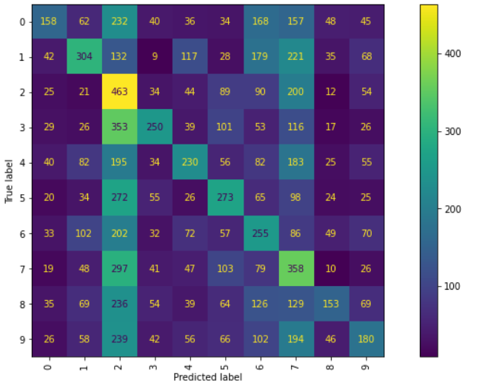
Results
Performance on modified test data: Accuracy: 27.3% (Confusion Matrix)

Slide 17
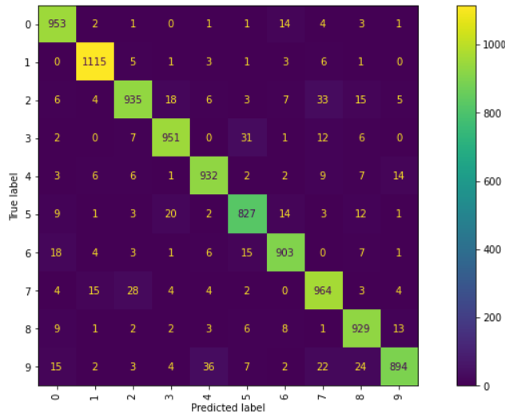
Results
Performance after training on augmented data: Accuracy: 94.03%(Confusion Matrix)

Slide 18
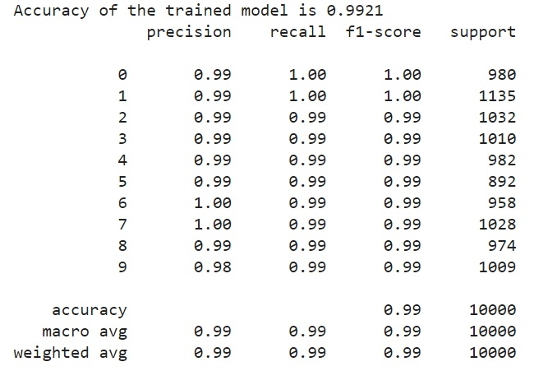
Results (Non Modified test Data)

Slide 19
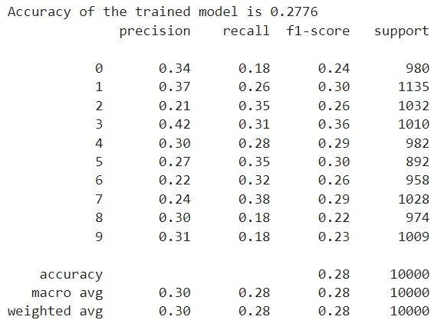
Results (Modified test Data)

Slide 20
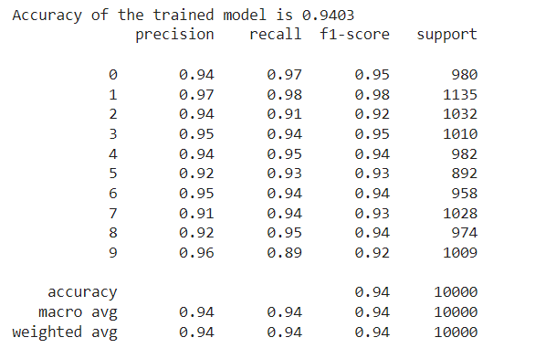
Results (Modified test Data & Augmented training data)

Slide 21
Conclusion
Digit recognition system has been successfully implemented
Dataset used in this research is MNIST
Dataset have ten main categories i.e. 0, 1, 2, 3, 4, 5, 6, 7, 8 & 9.
Two types of data are used for testing
Accuracies achieved are 99.2% on plain input and 94.6% on transformed data.

Slide 22
Any Questions?

Slide 23
Thank you!

